Slide 1
Moon Phases
And more!

Slide 2
Last time…
What causes the seasons?
In summer the (whole) Earth is closer to the Sun
In summer the tilt of the Earth’s axis makes the part of the Earth we are on closer to the Sun
In summer the Sun is up for more hours
In summer the Sun climbs higher in the sky so its rays hit the ground more directly
3 and 4

Slide 3
Last time…
What causes the seasons?
In summer the (whole) Earth is closer to the Sun
In summer the tilt of the Earth’s axis makes the part of the Earth we are on closer to the Sun
In summer the Sun is up for more hours
In summer the Sun climbs higher in the sky so its rays hit the ground more directly
3 and 4

Slide 4
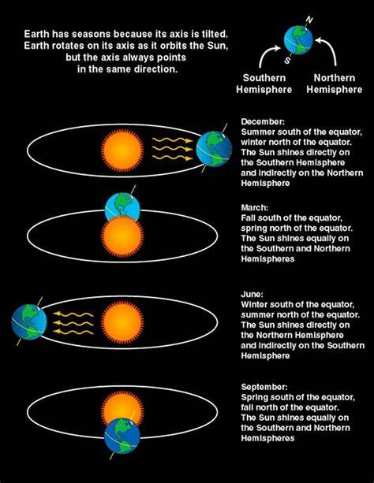
Last time…

Slide 5
Today you’ll be able to answer:
What are the phases of the Moon?
What time of day or night do you expect to see certain phases?
What are eclipses?
What types of eclipses are there?

Slide 6
Activity

Slide 7
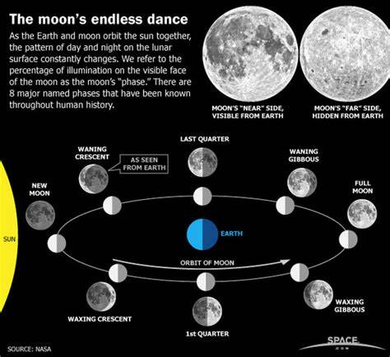

Slide 8
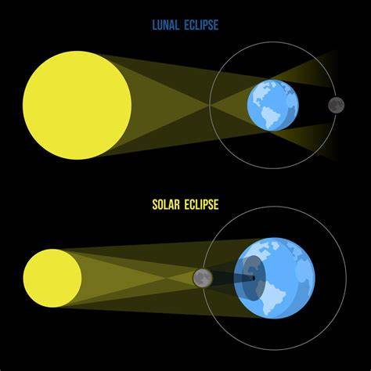

Slide 9
The full moon rises at approximately:
Midnight
Sunset
Sunrise
9 or 10 p.m.
It rises at different times during the year

Slide 10
The full moon rises at approximately:
Midnight
Sunset
Sunrise
9 or 10 p.m.
It rises at different times during the year

